Slide 1
An introduction to Opinion Dynamics
谢斌
2023.1.2

Slide 2
Content
Background: Why research the problem of opinion dynamics?
Methodology: Traditional models to research opinion dynamics
Opinion Dynamics and Bounded Confidence Models, Analysis, and Simulation
Meet, Discuss, and Segregate!
Thinking: The relation between GNN and opinion dynamics
Discussion: Several challenges for opinion dynamics, GNN for time series analysis

Slide 3
Background
In last decades, a series of opinion dynamics models with different opinion evolution rules have been proposed, such as: DeGroot model, FJ model, Time Variant model, Bounded Confidence model, DW model etc.
Traditional models are mainly used for theoretical analysis of the evolution of opinions between agents but cannot restore the evolution process of opinions between agents in real scenarios well.
With the development of the Internet, more and more people tend to share their opinions on social network platforms and obtain the opinions of other agents at the same time.
e-commerce platform——online shopping
Social media platform——share opinions and ideas
Knowledge crowdsourcing platform——acquire knowledge
However, sometimes the dissemination of opinion will have a certain impact on public opinion, so it is meaningful to propose a new method for studying the dissemination mechanism of opinion among users.
Data!

Slide 4
Content
Background: Why research the problem of opinion dynamics?
Methodology: Traditional models to research opinion dynamics
Opinion Dynamics and Bounded Confidence Models, Analysis, and Simulation
Meet, Discuss, and Segregate!
Thinking: The connection between GNN and opinion dynamics
Discussion: Several challenges for opinion dynamics, GNN for time series analysis

Slide 5
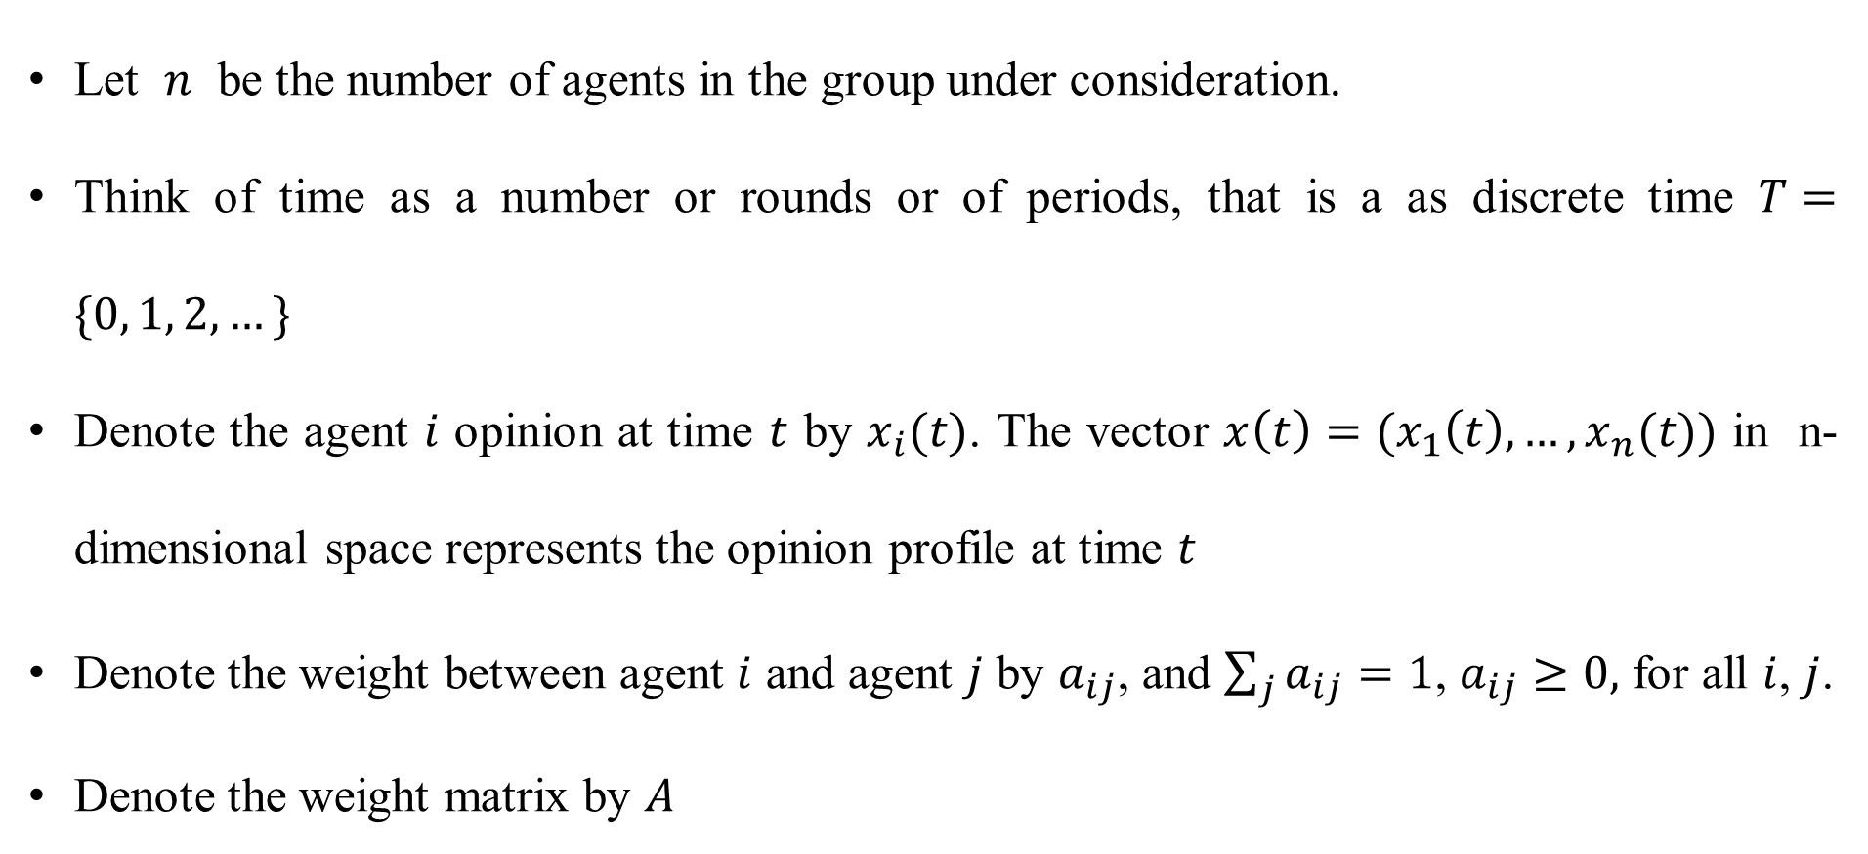
Notations
Let $n$ be the number of agents in the group under consideration.
Think of time as a number or rounds or of periods, that is a as discrete time $T=\{0, 1, 2,…\}$
Denote the agent $i$ opinion at time $t$ by $x_{i}(t)$. The vector $x\left(t\right)=(x_{1}\left(t\right), …,x_{n}(t))$ in n-dimensional space represents the opinion profile at time $t$
Denote the weight between agent $i$ and agent $j$ by $a_{ij}$, and $\sum_{j}{a_{ij}}=1$, $a_{ij}≥0,$ for all $i$, $j$.
Denote the weight matrix by $A$

Slide 6
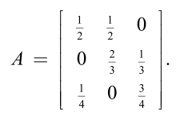
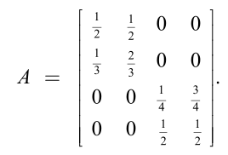
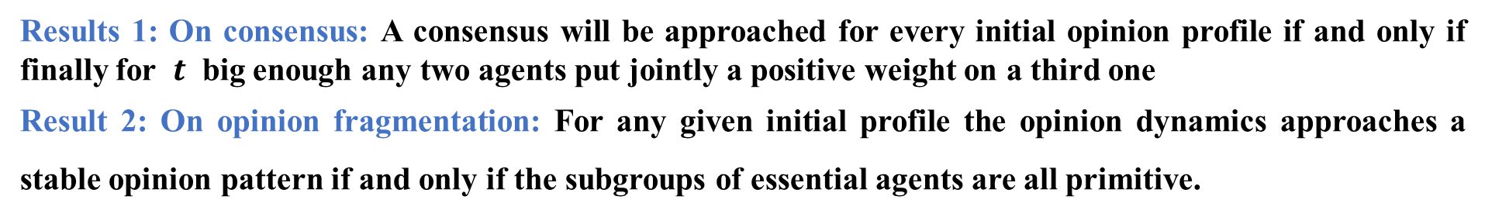
Models and Results
DeGroot model
马尔可夫过程具有收敛性，所以随着时间$t$的推移，每个个体$i$的观点将会收敛到某个特定的值。$x\left(t\right)=A^{t}x(0)$
Results 1: On consensus: A consensus will be approached for every initial opinion profile if and only if finally for $t$ big enough any two agents put jointly a positive weight on a third one
Result 2: On opinion fragmentation: For any given initial profile the opinion dynamics approaches a stable opinion pattern if and only if the subgroups of essential agents are all primitive.

Slide 7
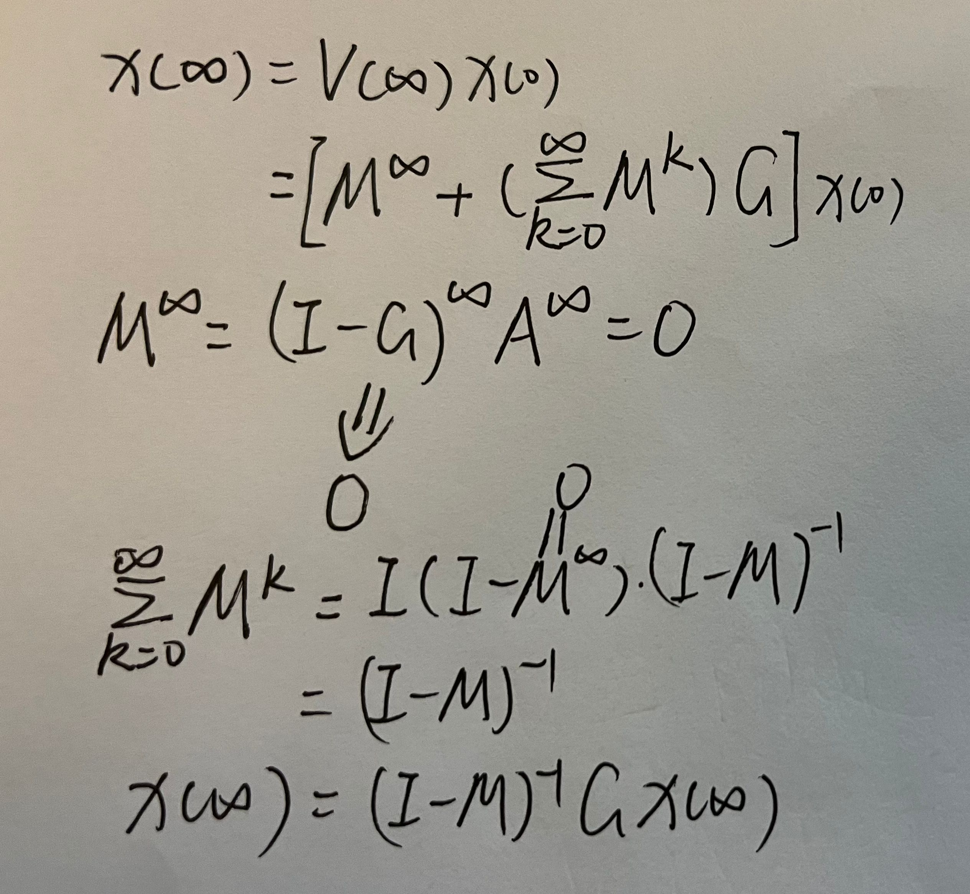
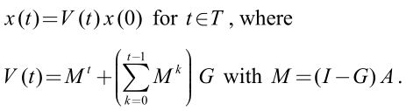
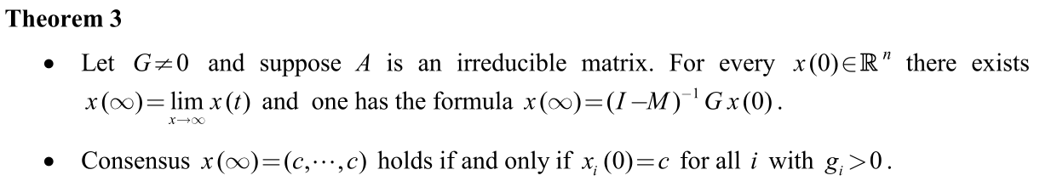
Models and Results
Friedkin and Johnsen’s Model
假设个体$i$以一定的程度$g_{i}$坚持最初的观点，那么其观点受其他个体影响的程度为$1−g_{i}$, 则DeGroot模型将改为如下形式
Results 3: On consensus or On opinion fragmentation with positive degrees: The above stable pattern represents a consensus if and only if there prevails already a consensus among all agents with positive degree.

Slide 8
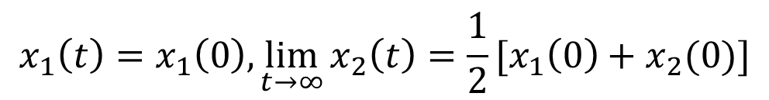

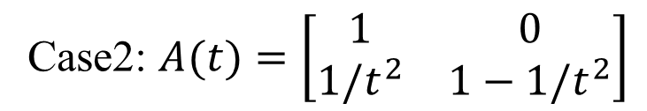
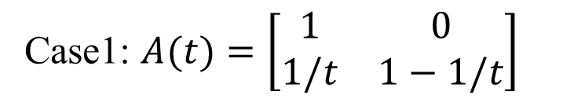


Models and Results
Time Variant model (TV)
权重矩阵会受到时间$t$的影响，不再是一个固定的值
Result 4: One time-variance consensus: Roughly speaking, the result says that for a consensus the weights
cannot tend too fast to zero because their sum should be infinite.
$\sum_{t=1}^{∞}{\frac{1}{t}}$ 发散
consensus
Case1: $A(t)=\left[\begin{matrix}1 & 0 \\ 1/t & 1−1/t\end{matrix}\right]$
$$x_{1}\left(t\right)=x_{1}\left(0\right), \lim_{t→∞}{x_{2}\left(t\right)=x_{1}(0)}$$
$\sum_{t=1}^{∞}{\frac{1}{t^{2}}}$ 收敛
fragmentation
Case2: $A(t)=\left[\begin{matrix}1 & 0 \\ 1/t^{2} & 1−1/t^{2}\end{matrix}\right]$
$$x_{1}\left(t\right)=x_{1}\left(0\right), \lim_{t→∞}{x_{2}\left(t\right)=\frac{1}{2}[x_{1}\left(0\right)+x_{2}(0)]}$$

Slide 9



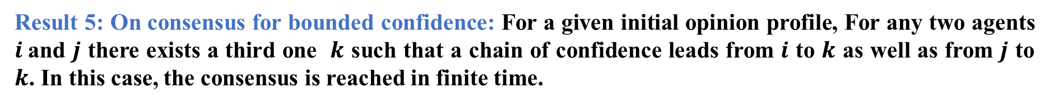
Models and Results
Bounded Confidence model (BC)
表示所有和个体$i$的观点差异小于$ε_{i}$的个体$j$的集合
假设集合中的个体$j$的观点对个体$i$的影响相同
Result 5: On consensus for bounded confidence: For a given initial opinion profile, For any two agents $i$and $j$ there exists a third one $k$ such that a chain of confidence leads from $i$ to $k$ as well as from $j$ to $k$. In this case, the consensus is reached in finite time.
Result 6: On opinion fragmentation for bounded confidence: For any given initial profile there exists a finite $T∈t^{∗}$and a division of all agents into maximal subgroups such that within each of the subgroups there holds a consensus for all $t≥t^{∗}$

Slide 10
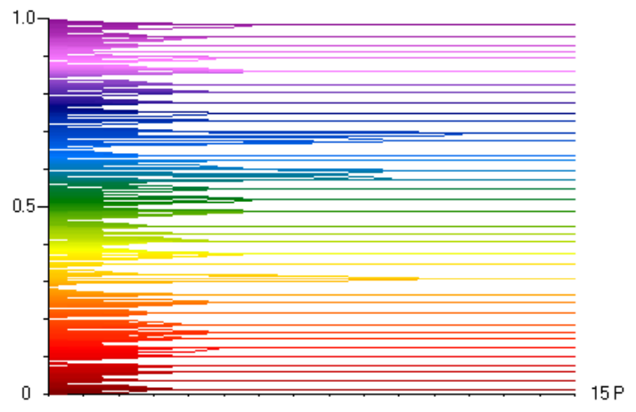
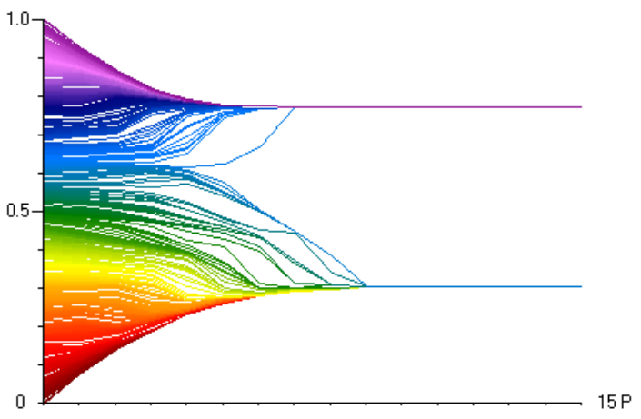
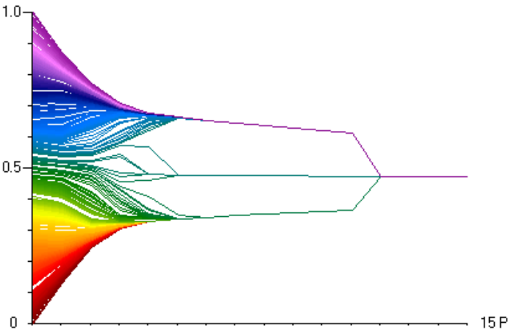



Models and Results
With the increase of parameter $ε$, agents’ views gradually changed from fragmentation to polarization, and finally reached consensus

Slide 11
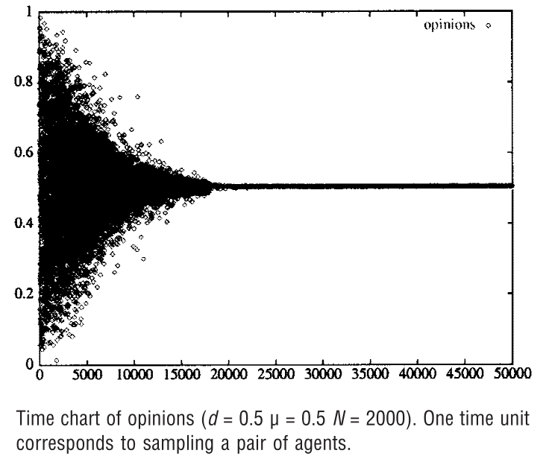
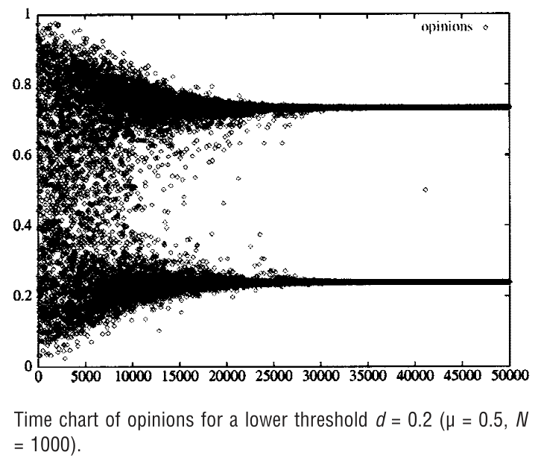
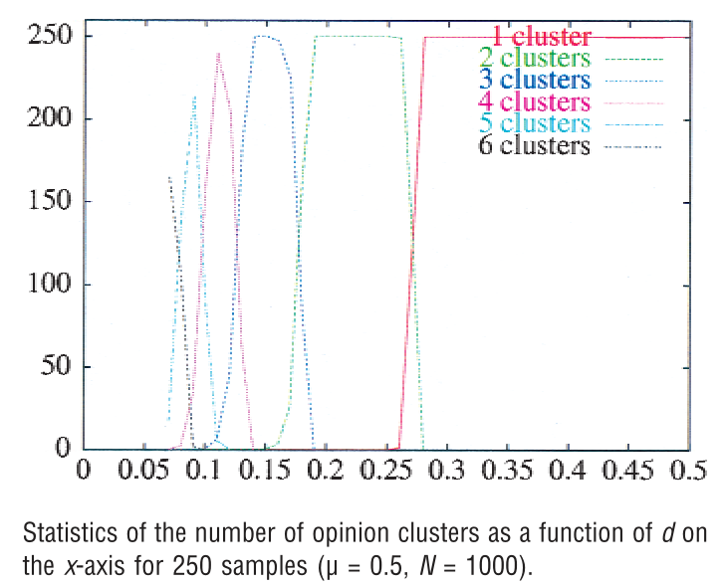



Models and Results
Defuant and Weisbuch’s Model (DW)
At each time step $t$ randomly choose any two agents $i$ and $j$,
$$x_{i}\left(t+1\right)=x_{i}\left(t\right)+μ(x_{j}\left(t\right)−x_{i}(t))$$
if $\left|x_{i}\left(t\right)−x_{j}\left(t\right)\right|<d$
$$x_{j}\left(t+1\right)=x_{j}\left(t\right)+μ(x_{i}\left(t\right)−x_{j}(t))$$
Result 6: On consensus and On fragmentation: The number of clusters varies as the integer part of 1/2d:
this is to be further referred to as the “1/2d rule”

Slide 12
Content
Background: Why research the problem of opinion dynamics?
Methodology: Traditional models to research opinion dynamics
Opinion Dynamics and Bounded Confidence Models, Analysis, and Simulation
Meet, Discuss, and Segregate!
Thinking: The connection between GNN and opinion dynamics
Discussion: Several challenges for opinion dynamics, GNN for time series analysis

Slide 13
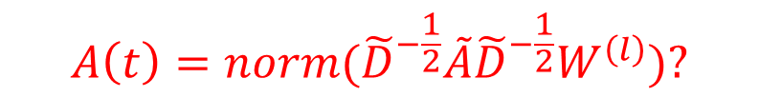
Compare with GCN
GCN: $ℋ^{(l+1)}=σ({\tilde{D}}^{−1/2}\tilde{A}{\tilde{D}}^{−1/2}ℋ^{(l)}W^{(l)})$
马尔可夫矩阵
DeGroot Model: $x\left(t+1\right)=Ax\left(t\right)$
在不考虑特征变换和非线性激活函数的情况下，GCN中的卷积操作可以看作是观点在一个周期内的演化过程
Friedkin and Johnsen’s Model：$x\left(t+1\right)=Gx\left(0\right)+\left(I−G\right)Ax(t)$
在不考虑特征变换和非线性激活函数的情况下，将最开始的输入接到了GCN中的每一层中。
Time Variant model (TV)： $x\left(t+1\right)=A(t)x\left(t\right)$
在不考虑非线性激活函数的情况下，将GCN中的每一层使用不同的权重矩阵$W^{(l)}$对邻接矩阵$A$做了一个特征变换，之后再对邻接矩阵$A$进行归一化。
$$A\left(t\right)=norm({\tilde{D}}^{−\frac{1}{2}}\tilde{A}{\tilde{D}}^{−\frac{1}{2}}W^{\left(l\right)})?$$

Slide 14
Compare with GCN
Over-Smooth: 随着网络层数的增加和迭代次数的增加，同一连通分量内的节点的表征会趋向于收敛到同一个值。
On Consensus: 随着时间的推移，所有个体的观点最终达成一致。
On Fragmentation: 随着时间的推移，所有个体的观点没有达成一致，而是分成若干个子组，这些子组中的每个个体的观点达成一致。但每个子组的观点并不相同
Over-Smooth
On Consensus
卷积操作可以抑制Over-Smooth，也就是如果引入了非线性因素，随着GCN卷积层数的增加，用GCN对观点演化进行研究可能更容易产生Fragmentation的情况？
从观点演化的角度来说，Over-Smooth的现象并不一定是不好的。并且如果可以用GNN模拟观点演化的过程，那么研究深层GNN模型也是有意义的

Slide 15
Content
Background: Why research the problem of opinion dynamics?
Methodology: Traditional models to research opinion dynamics
Opinion Dynamics and Bounded Confidence Models, Analysis, and Simulation
Meet, Discuss, and Segregate!
Thinking: The connection between GNN and opinion dynamics
Discussion: Several challenges for opinion dynamics, GNN for time series analysis

Slide 16
Challenge
怎么去定义或者量化一个人的观点？
一个人对一件事情的看法并不是单一的，如果简单地用一个数来衡量一个人的观点可能不是一个很好的方法
发表在社交平台上的消息不一定能反映用户的真实想法，怎么解决这个问题？
如果一个用户对某件事的评价是负面的，那么真的代表他对这件事的观点是负面的吗？
数据集和数据标注

Slide 17
Discussion
一定要用深度学习技术研究吗？可不可以用其他方法研究？
构建一个小世界网络，设定一系列的模型参数，利用计算机仿真的方法模拟观点演化的过程，
最后再根据真实数据对模型参数进行修正。
一个人的观点可能不一定只受到其他人的影响，是否应该考虑其他因素？
考虑特殊事件的发生、政策的改变以及舆论的走向等其他社会因素对个人观点的影响；还可以结合一些随机因素，比如某个个体的观点可能在某个时间发生了突变。
是不是可以观点演化看作是一个时间序列预测的问题？
如果用GNN来解决观点演化的问题，是不是可以考虑GNN+LSTM/Transformer的方法，针对序列问题进行建模。

Slide 18

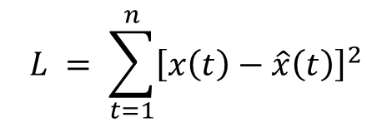









Discussion
Framework
$$profile\left(0\right);information(0)$$
$$profile\left(t\right);information(t)$$
Embedding
GNN
Layer
Embedding
GNN
Layer
$$concat[e\left(0\right);x(0)]$$
$$⋯⋯$$
$$concat[e\left(t\right);x(t)]$$
$$⋯⋯$$
$$\hat{x}(1)$$
$$\hat{x}(t+1)$$
$$output$$
$$L = \sum_{t=1}^{n}{{\left[x\left(t\right)−\hat{x}\left(t\right)\right]}^{2}}$$
$$output$$

Slide 19
References
Friedkin N E, Johnsen E C. Social influence and opinions[J]. Journal of Mathematical Sociology, 1990, 15(3-4): 193-206.
Zha Q, Kou G, Zhang H, et al. Opinion dynamics in finance and business: a literature review and research opportunities[J]. Financial Innovation, 2020, 6(1): 1-22.
Weisbuch G, Deffuant G, Amblard F, et al. Meet, discuss, and segregate![J]. Complexity, 2002, 7(3): 55-63.
Hegselmann R, Krause U. Opinion dynamics and bounded confidence models, analysis, and simulation[J]. Journal of artificial societies and social simulation, 2002, 5(3).
DeGroot M H. Reaching a consensus[J]. Journal of the American Statistical association, 1974, 69(345): 118-121.

